Slide 1
How to Survive
the
Chalk Talk
Some Steps to Prevent
the
Snowball Effect

Slide 2
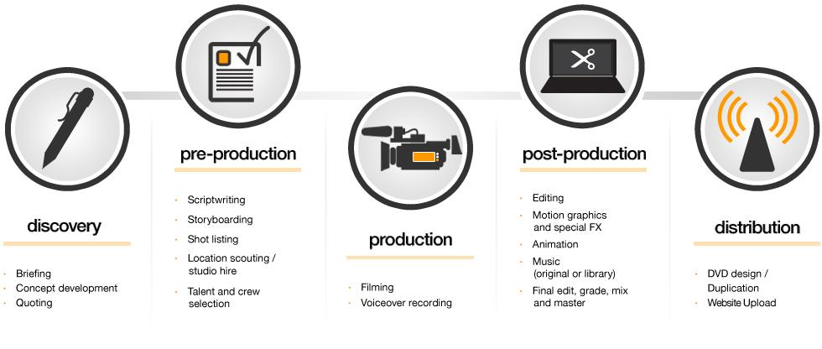
Process
Use this to keep it simple and make effective use of your time
Script
Storyboard
Shoot
Edit
“Rinse and Repeat”

Slide 3
Videography Website
Know Your Resources!
Tutorial Videos
Start Here
These are short and essential
Literature
Aesthetic Tips
Video Grammar

Slide 4
Methods
Use Technology to your advantage
ELMO (document camera)
Screen Capture (ZOOM)
Rutt House Huge TV
Voice Over

Slide 5
Start Early
Research
Generate ideas for execution
Bits and pieces
Increased project quality

Slide 6
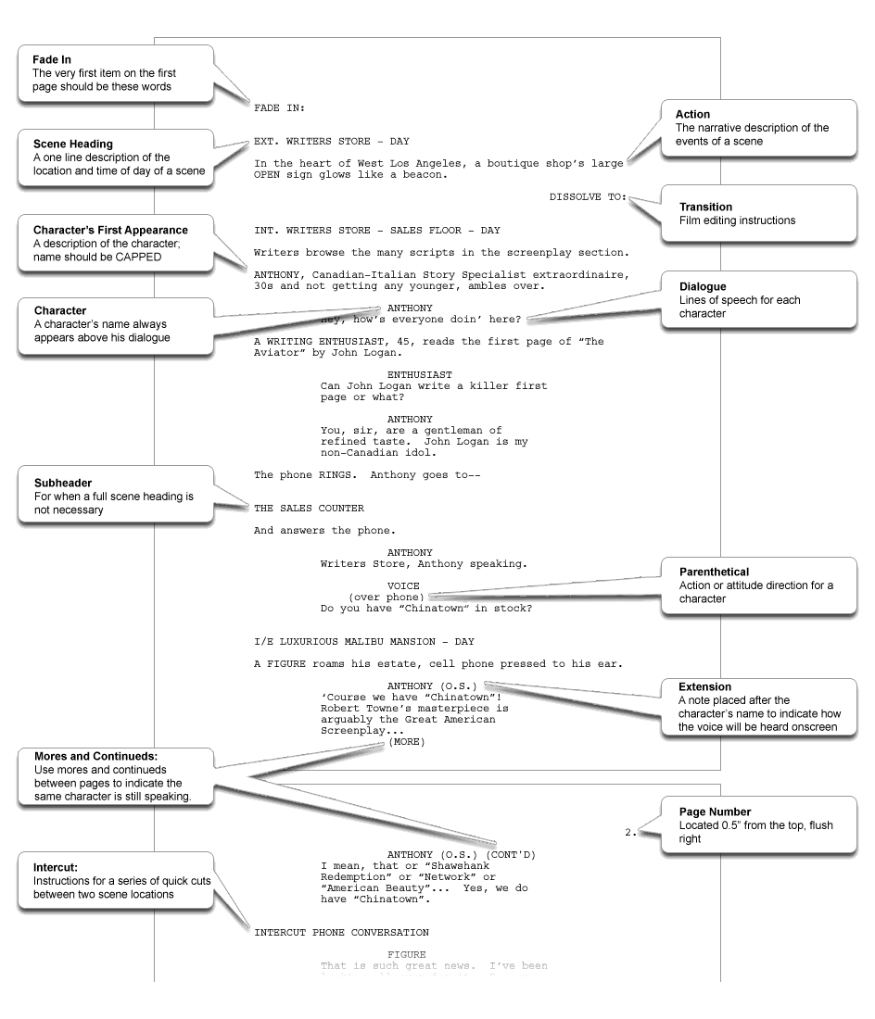
Script
Dialogue
Direction

Slide 7
Story Board
Template: https://moodle.emu.edu/course/view.php?id=11902
Purpose: A tool to guide your “visual script”
Images/visuals with associations and intended dialogue
A way to organize your thoughts for each scene and intended length.
Expectations and necessary props needed for each scene
Place scenes in sequential order

Slide 8
Editing and Shooting/Re-shooting
Make sure to give yourself an adequate amount of time to re-shoot/edit
Suggestions: Use Moviemaker, iMovie, etc.
Be sure to add time stamps at the end of each reference (reference screen).
Images and labels need to be clear and concise.
Communicate with your group members so that you guys are on the same page and can assist one another.

Slide 9
Advisory Sessions
Set appointment well in advance with assigned GA
NOT THE WEEK OF
Come with ideas
GA’s provide direction and advice
videoga@emu.edu
set up appointments

Slide 10
End/Contact
Advisory Sessions & Questions
videoga@emu.edu
Camera Checkout
videoga@emu.edu or
Cheryl Doss - dossc@emu.edu

